Slide 1

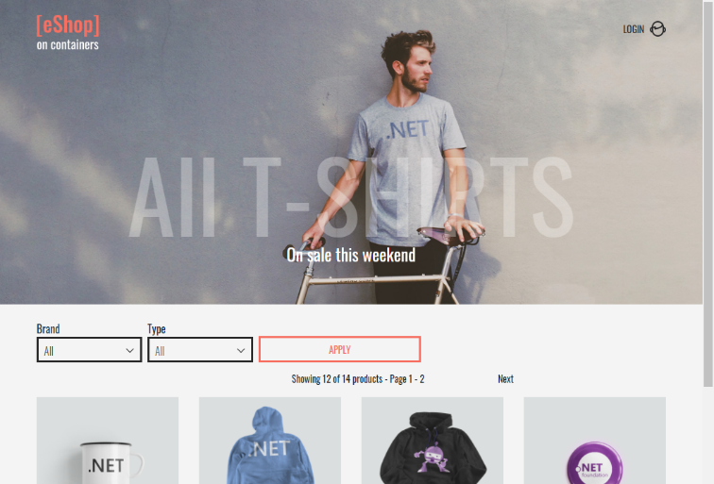
QA – Final Project
Orders Microservice Team
eShopOnContainers by Microsoft
https://github.com/dotnet-architecture/eShopOnContainers

Slide 2
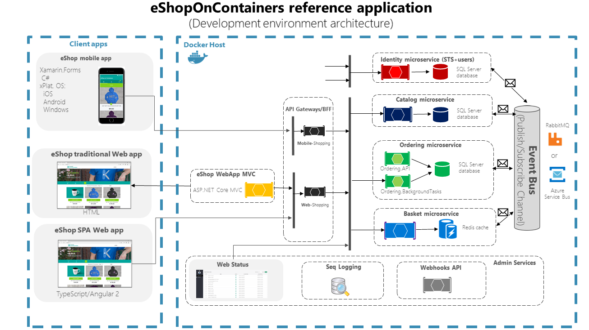
eShop Architecture

Slide 3

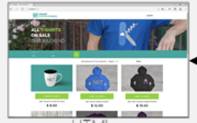





Unit Under Test
GUI
Ordering Service
Identity Microservice
SQL Server database
Catalog Microservice
Ordering Background Tasks
SQL Server database
SQL Server database
Basket Microservice
SQL Server database +n Redis
Ordering API
Payments Microservice
SQL Server database

Slide 4

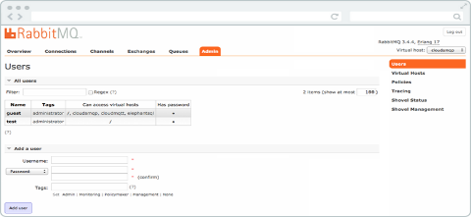


סביבת עבודה
GUI
Ordering Service: Unit Under Test UUT
Miocroservices Simulator
Ordering Background Tasks
Payment
Catalog Simulator
SQL Server database
Basket
Catalog
Ordering API
Identity

Slide 5
Test planning
Flow ordering
Test Data (ICD)
Requirements converting to TC
Executing a part of the TC in order to understand the result (using Postman)
Automation Test
Convert the test case into Python code
sent simulator messages using RabbitMQ
received and inserted data into the database
Receiving messages through RabbitMQ
Controlling the Docker containers
Testing an API using the Requests library

Slide 6
Test Data
Message Example | More Information
{ "UserId": "b9e5dcdd-dae2-4b1c-a991-f74aae042814", "UserName": "alice", "OrderNumber": 0, "City": "Redmond", "Street": "15703 NE 61st Ct", "State": "WA", "Country": "U.S.", "ZipCode": "98052", "CardNumber": "4012888888881881", "CardHolderName": "Alice Smith", "CardExpiration": "2024-12-31T22:00:00Z", "CardSecurityNumber": "123", "CardTypeId": 1, "Buyer": null, "RequestId": "097d108a-18e6-4644-b160-bcdd2ef87c18", "Basket": { "BuyerId": "b9e5dcdd-dae2-4b1c-a991-f74aae042814", "Items": [ { "Id": "c1f98125-a109-4840-a751-c12a77f58dff", "ProductId": 1, "ProductName": ".NET Bot Black Hoodie", "UnitPrice": 19.5, "OldUnitPrice": 0, "Quantity": 1, "PictureUrl": "http://host.docker.internal:5202/c/api/v1/catalog/items/1/pic/" } ] }, "Id": "16c5ddbc-229e-4c19-a4bd-d4148417529c", "CreationDate": "2023-03-04T14:20:24.4730559Z" | Description - Message to create a new order Routing key - UserCheckoutAcceptedIntegrationEvent
{ "OrderId": 71, "Id": "e9b80940-c861-4e5b-9d7e-388fd256acef", "CreationDate": "2023-03-07T09:52:56.6412897Z" } | Description - Message to confirm stock Routing key – OrderStockConfirmedIntegrationEvent Description - Message to payment successful Routing key – OrderPaymentSucceededIntegrationEven

Slide 7
Test Data
Message Example | More Information
{ "OrderId": 51, "OrderStockItems": [ { "ProductId": 1, "HasStock": false } ], "Id": "99c3f974-c6ed-41a4-8e01-5cb00f9e6335", "CreationDate": "2023-03-05T15:51:11.5458796Z" } | Description - Message to Rejected Stock Routing key - OrderStockRejectedIntegrationEvent
{ "OrderId": 51, "OrderStatus": "stockconfirmed", "BuyerName": "alice", "Id": "cca155c0-4480-4c93-a763-910e54218040", "CreationDate": "2023-03-05T17:07:35.6306122Z" } | Description - Message to Failed Payment Routing key - OrderPaymentFailedIntegrationEvent

Slide 8
Requirements
Order Management: The microservice should be able to manage the entire order process, including creating, updating, and canceling orders.
Order can be canceled only when it is in status submitted, awaitingvalidation or stockconfirmed)
Order Tracking: The microservice should provide online updates on the status of each order, including shipping information and delivery estimates.
Payment Processing: The microservice should integrate with a payment gateway to securely process payments from customers.
Inventory Management: The microservice should communicate with the inventory management system to ensure that products are available for purchase and to update inventory levels after an order has been placed.
Security: The microservice should implement robust security measures to protect customer data and prevent unauthorized access to sensitive information.
Scalability: The microservice should be designed to handle high volumes of at list 100 orders in one hour.
Reliability: The service can crash but when it is restarted it should continue from the point where it crashed

Slide 9
Test coverage
Order Management:
Test create order (MSS)
Test get orders
Test get order by id
Test get card type
Test cancel from status 1-3
Test cancel from status 4-5 (Negative)
Test update ship from status 4
Test update ship from status 1-3 , 6 (Negative)
Order Tracking:
1. Test order tracking
Payment Processing:
Test payment succeeded
Test payment failed
Inventory Management:
Test confirm stock
Test reject stock
Security:
Test cancel another user
Test payment another user
Test ship another user
Scalability:
Test hundred orders per hour
Reliability:
Test crash ordering service

Slide 10
Orders tests cases
Sanity test:
Create order
Test get orders
Test get order by id
Test get card type
Regression tests:
1. Ship status 1
2. Ship status 2
3. Ship status 3
4. Ship status 6
5. Cancel status 1
6. Cancel status 2
7. Cancel status 3
8. Cancel status 4
9. Cancel status 5
10. Order tracking
11. Payment succeeded
12. Payment failed
13. Confirm stock
14. reject stock
Non functional tests:
1. Cancel another user
2. Payment another user
3. Ship another use
4. Test hundred orders per hour
5. Test crash ordering service

Slide 11
Test MSS
Test steps | Expected result
Basket simulator send message With routing key: UserCheckoutAcceptedIntegrationEvent | New order is created with “OrderStatusId” 1 in DB Basket simulator receives message Routing key: OrderStartedIntegrationEvent ordering-backgroundtasks update “OrderStatusId” to 2 Catalog simulator receives message Routing key: OrderStatusChangedToAwaitingValidationIntegrationEvent
Catalog simulator send message With routing key: OrderStockConfirmedIntegrationEvent | update “OrderStatusId” to 3 Payment simulator receives message Routing key: OrderStatusChangedToStockConfirmedIntegrationEvent
Payment simulator send message With routing key: OrderPaymentSucceededIntegrationEvent | update “OrderStatusId” to 4 Catalog simulator receives message Routing key: OrderStatusChangedToPaidIntegrationEvent

Slide 12
reliability
steps | Expected result
Basket simulator send message With routing key: UserCheckoutAcceptedIntegrationEvent | New order is created with “OrderStatusId” 1 in DB Basket simulator receives message Routing key: OrderStartedIntegrationEvent ordering-backgroundtasks update “OrderStatusId” to 2 Catalog simulator receives message Routing key: OrderStatusChangedToAwaitingValidationIntegrationEvent
Turn off the ordering api container And then Turn on the ordering api container
Catalog simulator send message With routing key: OrderStockConfirmedIntegrationEvent | update “OrderStatusId” to 3 Payment simulator receives message Routing key: OrderStatusChangedToStockConfirmedIntegrationEvent
Turn off the ordering api container And then Turn on the ordering api container
Payment simulator send message With routing key: OrderPaymentSucceededIntegrationEvent | update “OrderStatusId” to 4 Catalog simulator receives message Routing key: OrderStatusChangedToPaidIntegrationEvent

Slide 13
Report Bugs
Three failed tests and the steps to reproduce the bug:
cancel another user
Basket simulator send message With routing key: UserCheckoutAcceptedIntegrationEvent Creating an order with another user
The last generated ID is extracted from the DB and verifies that his status is 1
Ordering api cancel send message with an ID issued from the DB
Status code is equal to 200 instead of 401
payment another user
Basket simulator send message With routing key: UserCheckoutAcceptedIntegrationEvent Creating an order with another user
Catalog simulator send message With routing key: OrderStockConfirmedIntegrationEvent
Payment simulator send message With routing key: OrderPaymentSucceededIntegrationEvent
The last generated ID is extracted from the DB and verifies that his status is not 4
ship another user
Basket simulator send message With routing key: UserCheckoutAcceptedIntegrationEvent Creating an order with another user
Catalog simulator send message With routing key: OrderStockConfirmedIntegrationEvent
Payment simulator send message With routing key: OrderPaymentSucceededIntegrationEvent
Ordering api ship send message with an ID issued from the DB
Status code is equal to 200 instead of 401

Slide 14
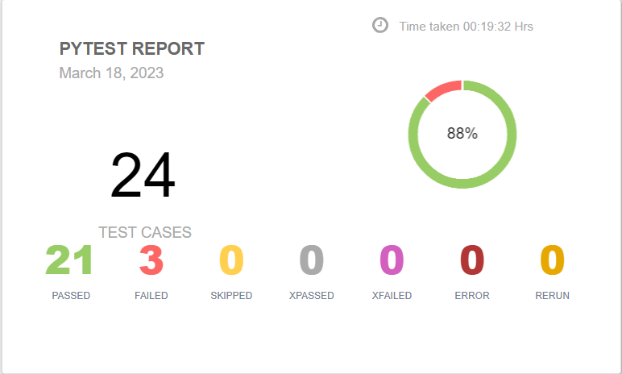
Report

Slide 15
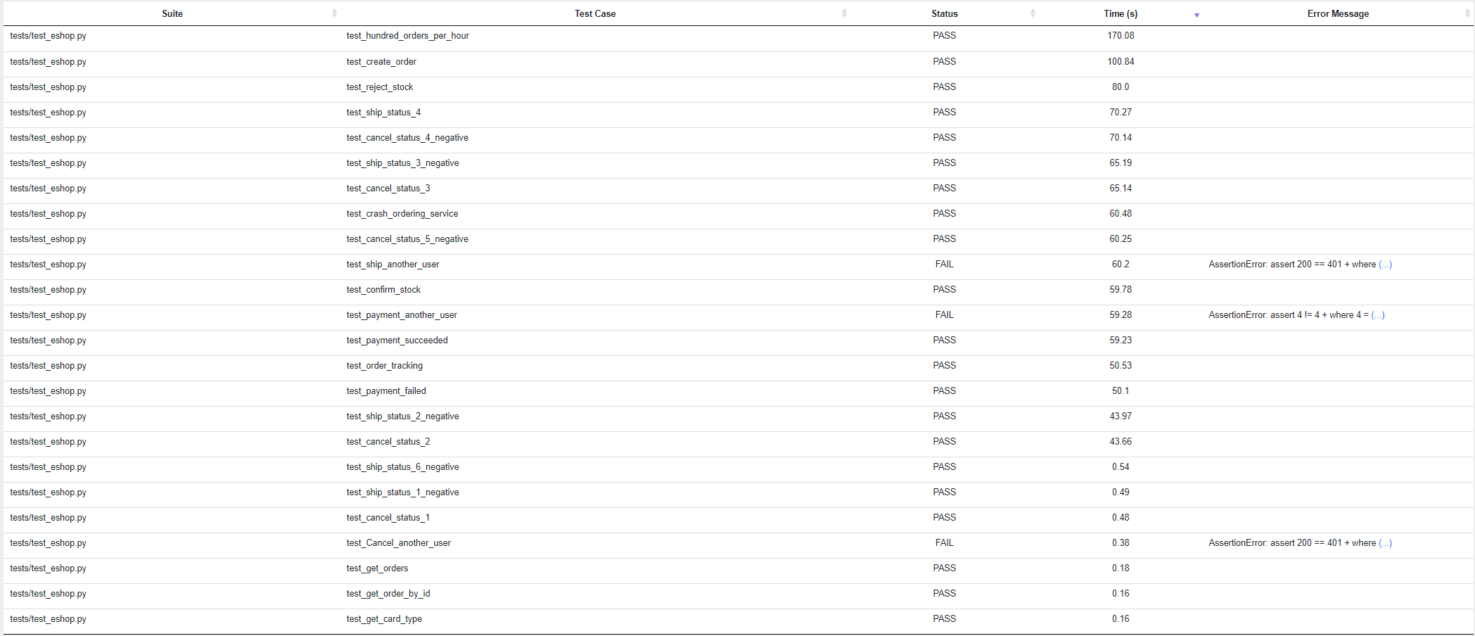
Report

Slide 16
Thank you for listening

